Slide 1

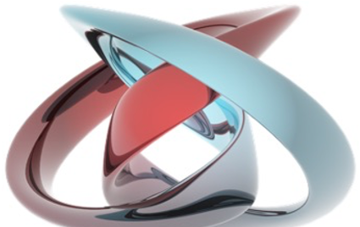
mesoscopic and nanoscale physcis
Laboratory of Quantum Physics: Topology and Correlations
Quantum transport in Mesoscopic systems
(PHYS-462)
Mitali Banerjee (LQP)
mesoscopic physics deals with the physics of small objects consisting of a collection of atoms
nanometer scale
Length scale
atoms
molecules & clusters
electron mean free path
bulk materials
micro
meso
macro
Ref: Supriyo Dutta/ H.S.J. van der Zant (TU Delft)

Slide 2
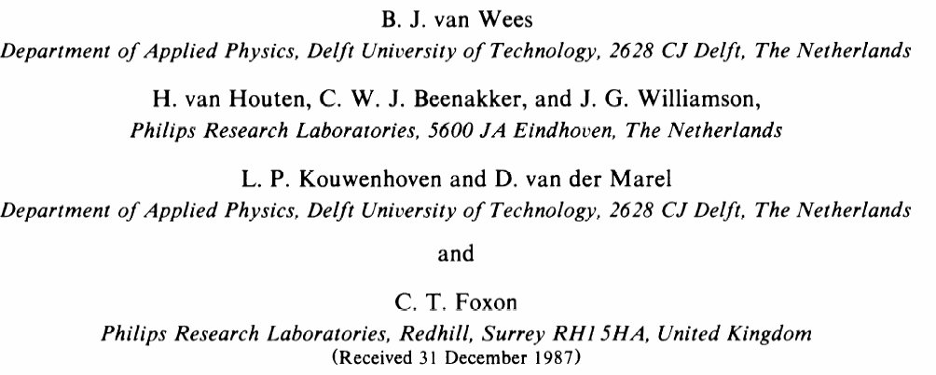
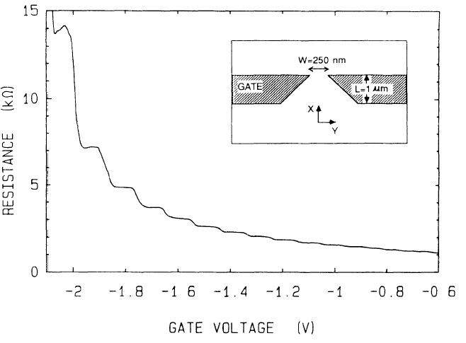

Slide 3
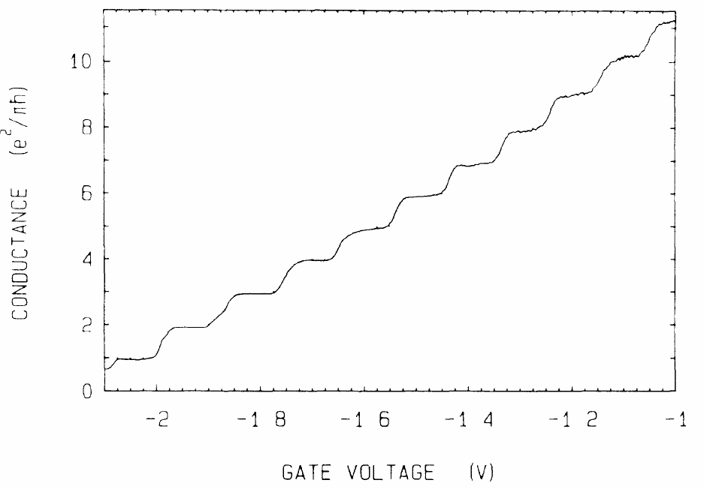
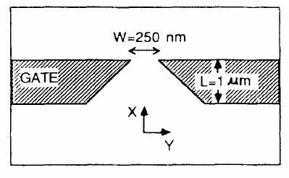

Slide 4
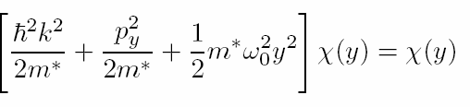
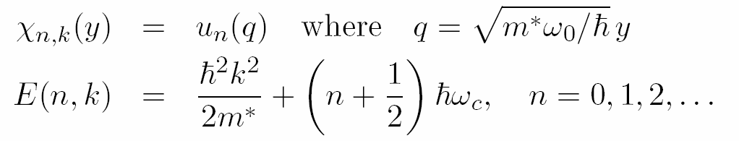
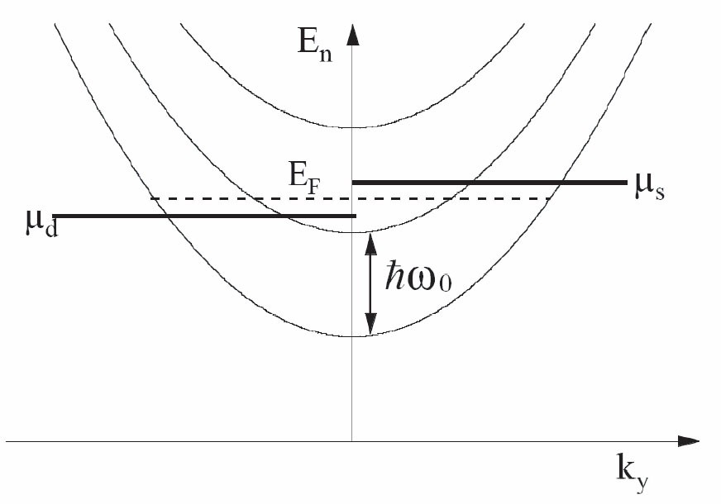

x

Slide 5
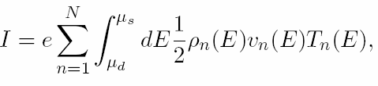
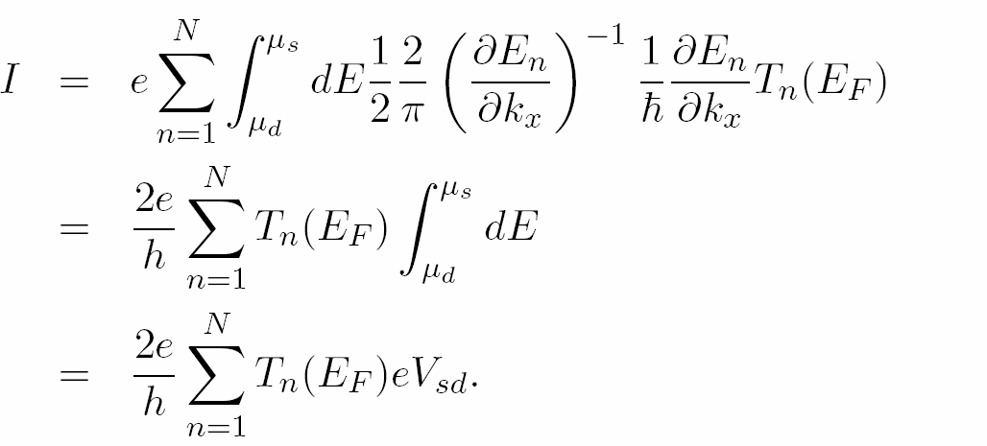
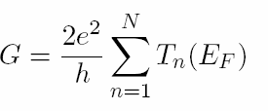
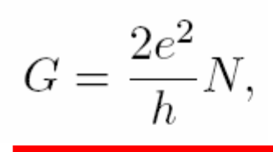

Slide 6
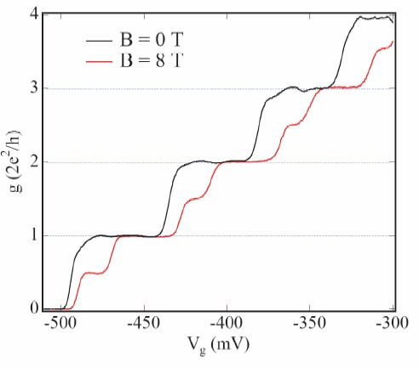

Slide 7
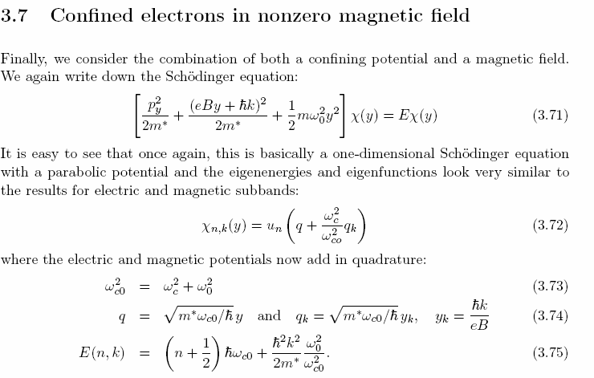

Slide 8
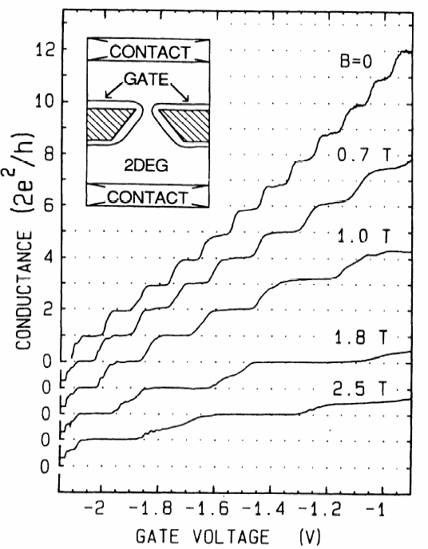

Slide 9
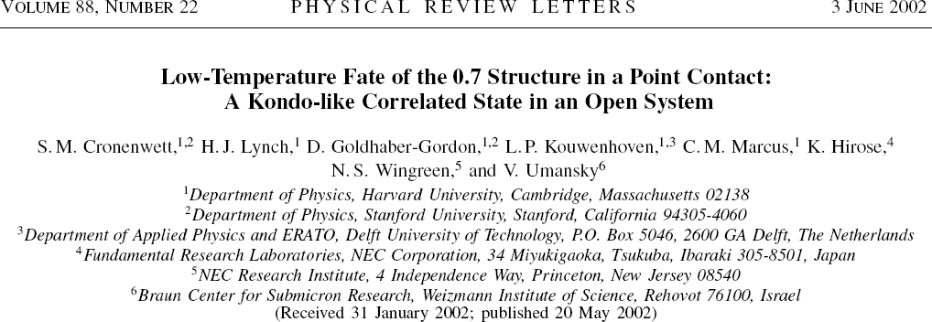
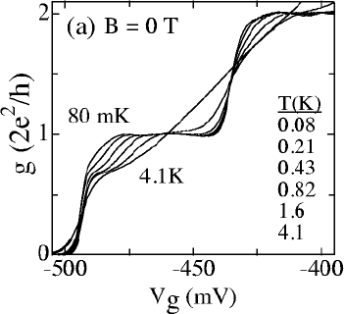
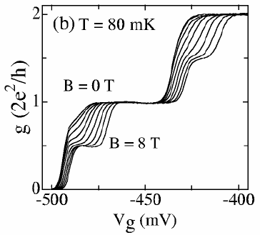
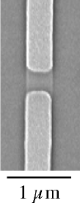

Slide 10
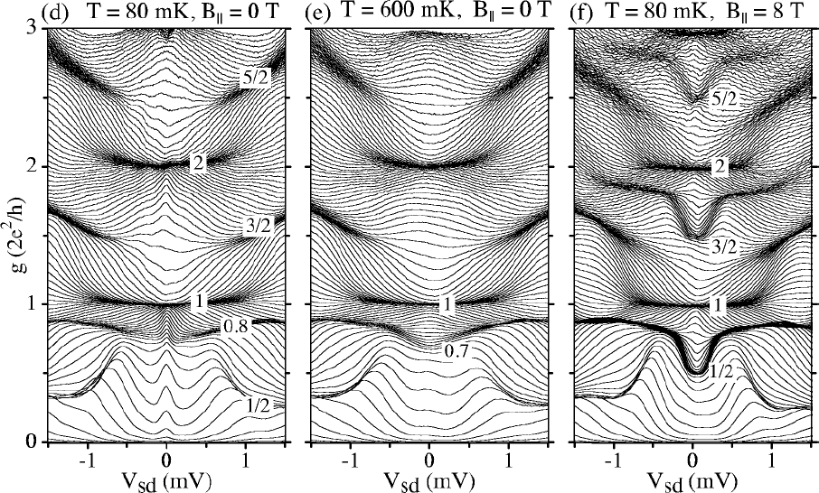

Slide 11
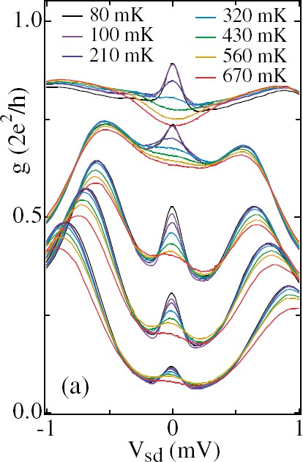
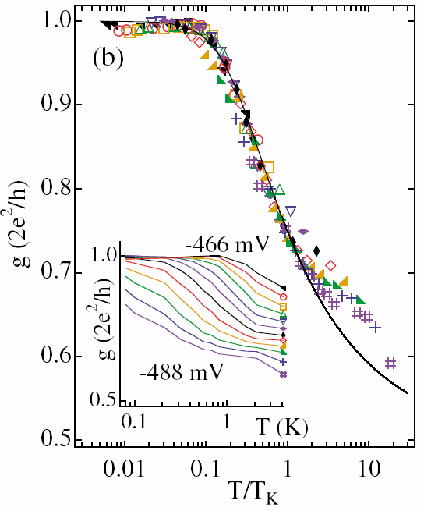

Slide 12
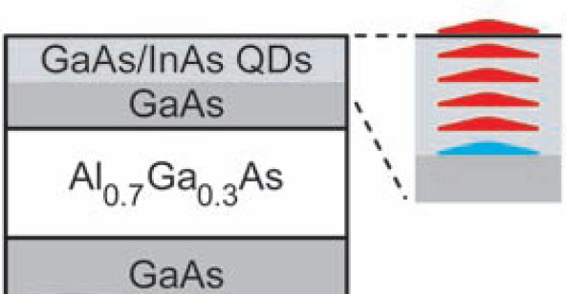
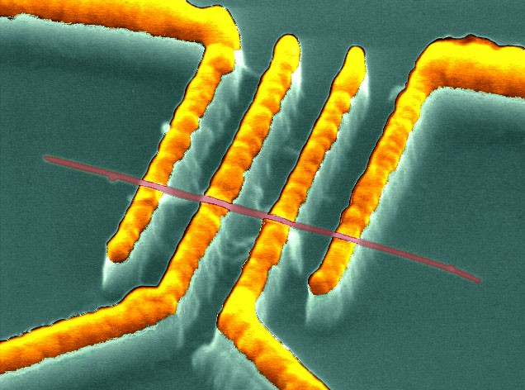
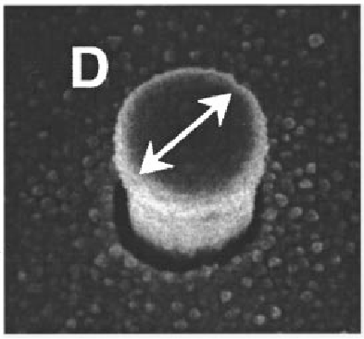
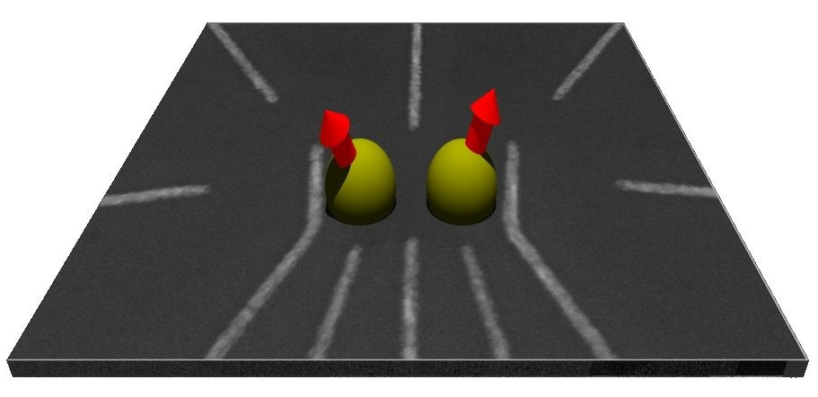
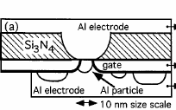
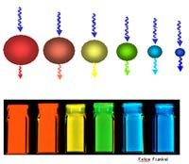
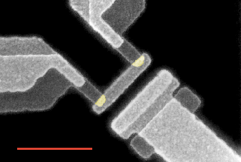
Quantum Dots
MBE grown
nanotube
vertical dot
lateral
metal grain
self assembled
metallic SET

Slide 13
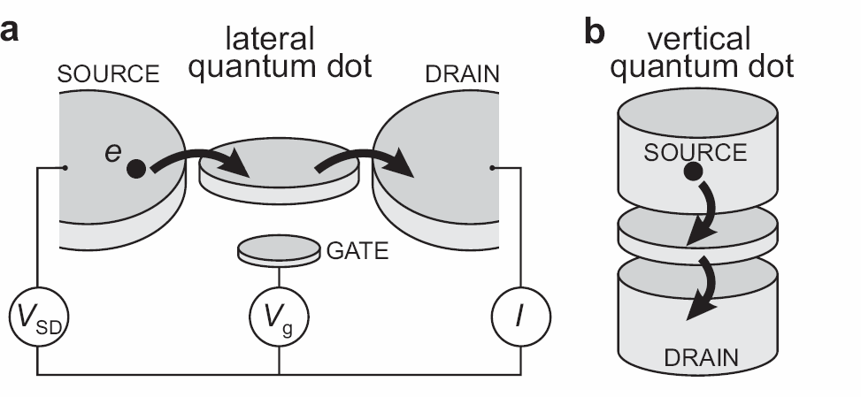
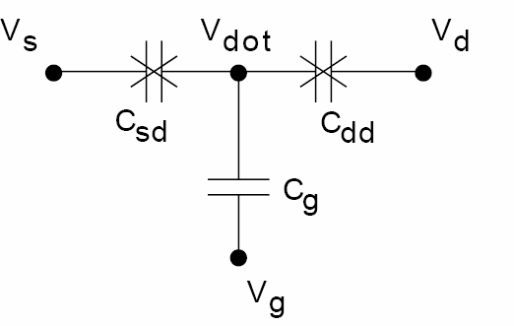
lateral vs. vertical
an electrical engineers point of view

Slide 14
Lateral Dots: Formed in GaAs/AlGaAs 2DEG
Electrons travel in sub-surface layer:
CONTACT GATE CONTACT
+
+₊₊
Fermi energy
⁺⁺⁺ + + + +
doping layer
Only lowes sub-band occupied at low T
Surface
GaAs
Al_{0.3}Ga_{0.7}As
GaAs
Negative voltage on gates depletes underlying electrons & defines dot cavity
I (pA)

Slide 15
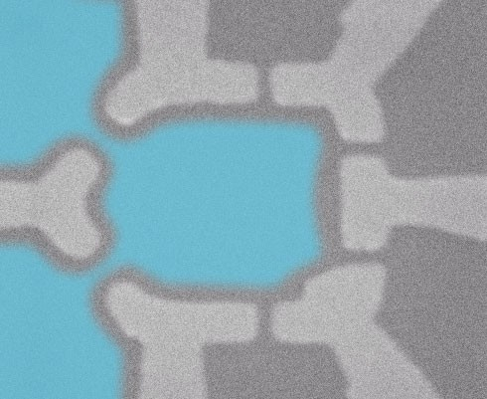
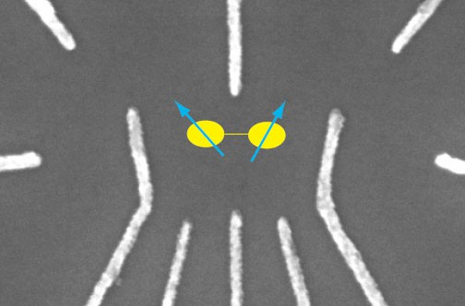
gate defined dots
A
3
B
point contacts
B
2
C
1
C 1
X 2
A
A,B,C : control quantum point contacts transmission to reservoirs
1,2,3: control confinement potential / energy levels only
X control dot-internal tunneling rate

Slide 16
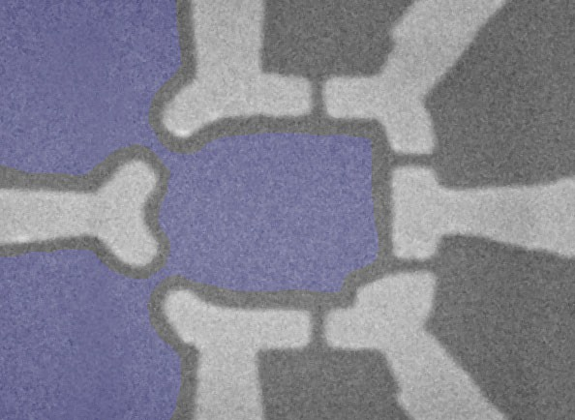
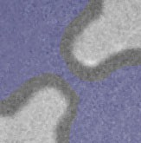
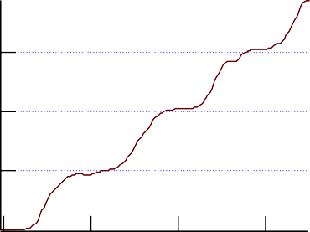
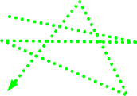

Quantum Point Contact Leads
0
2
4
6
8
2
g (e /h)
^{V}QPC1
-0.1
8
6
-0.2
4
2
-0.3
0
-0.4
V_{NOSE} (V)
^{V}NOSE
-0.5
-0.6
Not all QPCs are perfect:
-0.7
300
200
100
0
-100
-200
-300
-0.6
-0.4 -0.2
V_{QPC1} (V)
0.0
Nose (mV)
6
2
g (e /h)
4
2
0
100
V_{G} (mV)
-200
0
QPC2 (mV)
200
I
0
50
150
1 µm
slide from A. Huibers, Thesis (1999)

Slide 17
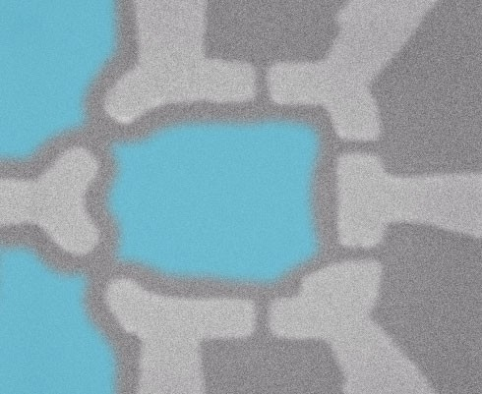
Open vs. Closed
Open Dot
Closed Dot
point contacts
2
V_{gate} set to allow ≥ 2e /h conductance
through each point contact
Dot is well-connected to reservoirs
V_{gate} set to require tunnelling across point contacts
Dot is isolated from reservoirs, contains discrete energy levels
Transport measurements exhibit Coulomb Blockade
Transport measurements exhibit CF and Weak Localization

Slide 18
Coulomb Blockade in Closed Dots
Finite energy E =e²/C is needed to
c dot
add an additional electron to the dot. When kT<<E_{c} charging blocks conduction in valleys.
Coulomb blockade peaks:
resonant transport through dot levels
0.15
g (e²/h)
0.10
N
N+1
N+2 . . .
1 μm²
0.05
0.00
-198 -196
V (mV)
-200
-194
V

Slide 19
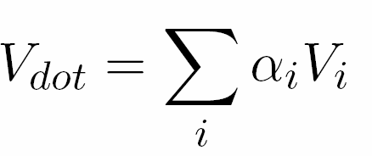
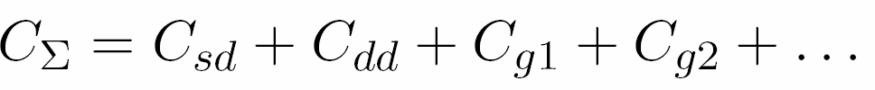
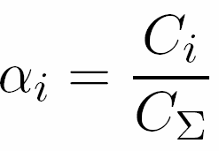
Electrostatic Energy
apply voltages
what is potential on dot? voltage divider...
can use V_{g} to shift dot energy!!

Slide 20
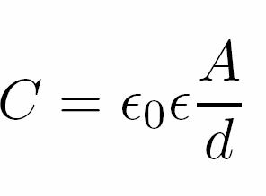
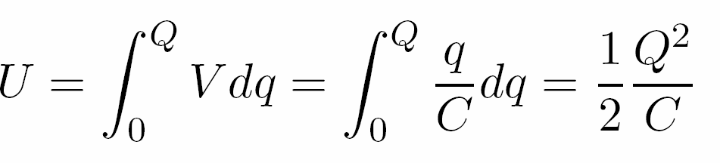
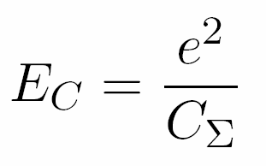
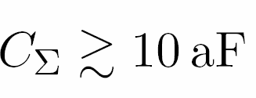
Charging Energy
capacitance of dot to world = C
energy stored in capacitor
charging energy
can range from
~0 to many meV
Classical Effect, NOT quantum

Slide 21
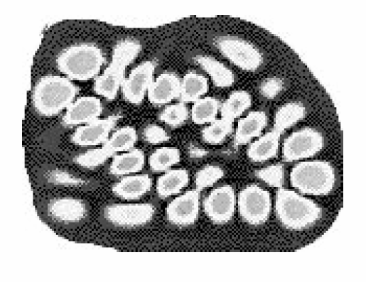
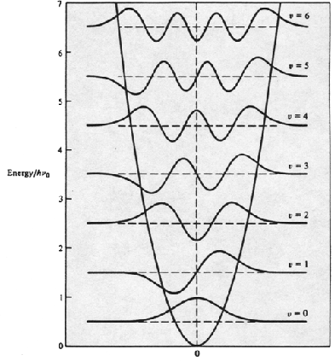
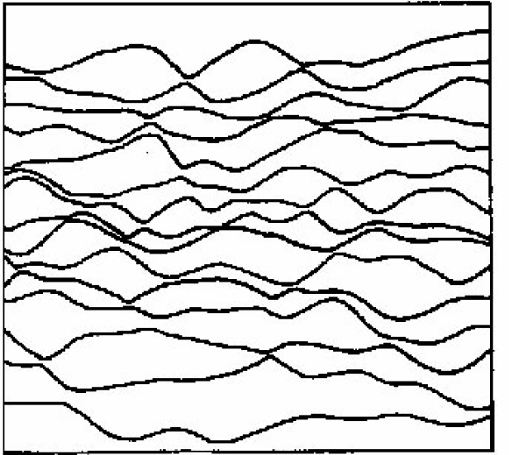
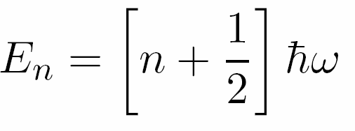
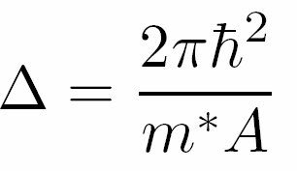
Confinement Energy
harmonic potential
complicated potential
E
x
average level spacing
μeV to meV
quantum mechanical effect!!

Slide 22


Capacitor Model
total dot energy
offset charge

Slide 23






Constant Interaction Model
: interaction of electron k with rest
constant inteaction: model ϕ_{k} with C_{Σ}
total dot energy

Slide 24



Chemical Potential / Addition Energy
energy to add one more electron
μ=0: change N current flows
constant interaction model:
addition energy

Slide 25
Quantum Coulomb Blockade
kT ~ 3μeV
Δ ~ 10μeV Ec ~ 200μeV
B=0 mT B=20 mT
0.20
0.15
g (e²/h)
0.10
0.05
0.00
-250
-200
-150
V (mV)
-100
-50
0
For kT < Δ, each peak describes tunnelling into a single eigenstate. Wavefunction amplitude fluctuations lead to peak height fluctuations.
V
slide from J. Folk (2002)

Slide 26



Coulomb Diamonds
kT ~ 1.5μeV
Δ ~ 1000μeV Ec ~ 2000μeV
^{V}SD
differential conductance: peaks when current through dot is changing
200nm
I

Slide 27

Coulomb Diamonds
peaks in g appear when dot level aligned with either source or drain chemical potential
-eV_{SD}
^{V}SD
200nm
I

Slide 28





Coulomb Diamonds, Sequential Tunneling Transport
electrons tunnel on / off dot one by one
(charging energy)
electrons do not change energy when tunneling
dot energy unchanged

Slide 29

Coulomb Diamonds
^{E}add
two slopes, each associated with its respective dot-lead capacitance

Slide 30

Excited State Spectroscopy: Sequential Transport
lab to investigate quantum levels in device!!
quantum confinement energies
internal excitations (spin)
A
B C
A
B
C
2ES
1ES GS
2ES
1ES GS
2ES
1ES GS
-eV_{SD}
-eV_{SD}
-eV_{SD}
only one excess electron can be on dot (charging energy)

Slide 31

Cotunneling Transport
inelastic cotunneling
(white lines)
dot energy changes only possible for V_{SD}>Δ
before tunneling
-eV_{SD}
Δ
higher order process:
two electrons tunnel and change energy
^{V}SD
>Δ
elastic cotunneling (blue circle)
after
dot energy
unchanged
-eV_{SD}
dot now in excited state
Δ
before tunneling
after

Slide 32




Temperature Regimes
no charging effects, no Coulomb blockade
classical Coulomb blockade (metallic CB)
temperature broadened
transport through several quantum dot energy levels
peak conductance idependent of T FWHM ~ 4.35kT
Γ = Γ_{L} + Γ_{R}
escape broadening (tunneling rates)

Slide 33





Temperature Regimes
quantum Coulomb blockade temperature broadened regime resonant tunneling
transport through only one dot level
peak conductance 1/T FWHM ~ 3.5kT
quantum Coulomb blockade lifetime broadened regime transport through only one dot level
peak conductance e²/h indep. of T FWHM ~ Γ

Slide 34


Temperature Dependence: Theory
Δ= 0.01 e²/C
kT / e²C
a 0.075
b 0.15
c 0.3
d 0.4
e 1
f 2
van Houten, Beenakker & Staring, NATO ASI Series

Slide 35


Temperature Dependence: Experiment
inverse peak height
4.4 kT
peak width
3.5 kT
crossover 3.5 to 4.3kT peak width peak g
1/T dependence: quantum regime T independent: cassical regime
Foxman et al., PRB50, 14193 (1994)

Slide 36


Line Shapes: Experiments
T-broadened
lifetime broadened
Foxman et al., PRB47, 10020 (1993)

Slide 37


Charge Switching / Telegraph Noise
Elzermann, 2003

